Slide 1
Introducing node.js

Slide 2
Agenda
Install Node.js
Understand the power of Node.js
Discuss Node.js architecture
Use nvm & npm
Understand module system
Control flow strategies
General topics

Slide 3
What
Node.js is a server side JavaScript platform
Built on Chrome’s V8 engine
Is open source
Single threaded
Event-driven, non blocking I/O
Developed in 2009 by Ryan Dahl
Supported by Joyent

Slide 4
Node.js as a Web server
According to w3techs.com Node.js has only 0.4% market share
Still, it gains more and more popularity
~1million web sites world wide
PHP is ~40 million
Top web sites
Aliexpress.com
bbc.com
outbrain.com
flickr.com

Slide 5
Node.js as BFF
Node.js cannot easily replace existing server side infra written in Java/.NET
Common scenario is to put Node.js at the front of Java/.NET → Backend for Frontend
Usually is controlled by Front End engineers
Thus allowing the developer to push JavaScript code to the server
Improve client side performance

Slide 6
Node.js as Development Tools
This is where Node.js really shines
Extreme echo system of development tools
Build tools – Webpack, Gulp, Grunt
Compilers – Typescript, Babel
Testability – Selenium, Jasmine, Mocha
Desktop applications – VSCode, GithubDesktop

Slide 7
When should we use?
Node.js is great when most work is I/O
Think of a web server. The “hard” work relates to
HTTP → Networking I/O
Database → Networking I/O
File system
The server is more of a controller/facade

Slide 8
When NOT to use
Heavy server-side computation
Can offload the “hard” work to background processes
Can use threads (not common)
Direct access to OS API is required
Can integrate C/C++ code

Slide 9
Installation
Depends on the OS
Starts with https://nodejs.org
Amazingly you can just download Node.js as a tar/zip file and start using it
https://nodejs.org/dist/latest-v8.x/
On Windows you may execute nodevars.bat which fixes the PATH with
node
npm

Slide 10
NVM
Each Node.js project may be dependent on different Node.js version
Can resolve that by installing Node.js per project
Less common
NVM allows managing multiple versions of Node.js at the machine level while having only ONE active version at a time

Slide 11
NVM
Ensure you don’t have any previous installation of Node.js
nvm list – Get a list of all installed versions
nvm install latest – Installs latest Node.js version
nvm use 9.8.0 – Configure machine to use the specified version

Slide 12
Hello World Sample
Create new main.js file
Paste the following
From the command line execute
Can it be simpler ?
console.log("Hello Node.js");
node main.js

Slide 13
Http Server Sample
const http = require('http'); const requestHandler = (req, res) => { res.end('Hello Node.js Server!'); } const server = http.createServer(requestHandler); server.listen(3000, (err) => { if (err) { return console.log('something bad happened', err); } console.log(`server is running`); });

Slide 14
Better abstraction with Express
npm install express
const express = require("express"); const app = express(); app.get("/api/contact", function (req, res) { res.json([ {id: 1, name: "Ori"}, {id: 2, name: "Roni"} ]); }); app.listen(3000, function() { console.log("Server is running"); });

Slide 15
Toolings
But what if we just need a simple web server that returns static content from current directory
No need to re-implement that
npm install http-server
node_modules/.bin/http-server
A web server is up and running on port 8080 …

Slide 16
Typscript
Adds type safety to Node.js
npm install typescript
npx tsc -init
npm install @types/node
npx tsc
import * as fs from "fs"; fs.readFile("main.ts", function(err, data: string) { console.log(data); });
Typescript generates compilation error ☺

Slide 17
Quick Exercise
Install nvm
Install Node.js using nvm
Create a simple HTTP echo server using Express
/api/echo/hello → Returns “hello”

Slide 18
node.js architecture

Slide 19
Agenda
Discuss Node.js architecture
Understand main characteristics
Write some code

Slide 20
Characteristics
Built on Chrome’s V8 engine
Uses libuv
Single threaded
Event-driven
Non blocking I/O

Slide 21
V8
JavaScript engine
Compiles JS to native machine code
Written in C++
Used in Chrome & Node.js
Supports Windows, macOS, Linux
Can be embedded into C++
Hello world sample

Slide 22
V8 vs. The World
Same role as Java’s JVM or .NET’s CLR
However, JavaScript is dynamic language
Therefore less optimization opportunities
V8 profiles code at runtime and optimizes it
Same as Java HotSpot technique
Has two compilers Full-Codegen & Crankshaft
Therefore can be faster than GCC
Shouldn’t be faster than Java/.NET
See some benchmarks

Slide 23
libuv
Multi platform library with focus on asynchronous I/O
Was developed for use by Node.js
But is now used by others
Supports all the goodies of Node.js
Event loop
Async TCP & UDP sockets
Async file system operations
IPC
More …
Create thread sample

Slide 24
libuv
When possible uses OS asynchronous API
Surprisingly does not use asynchronous file I/O
Code complexity
Poor APIs
Poor implementation
Uses thread pool instead

Slide 25
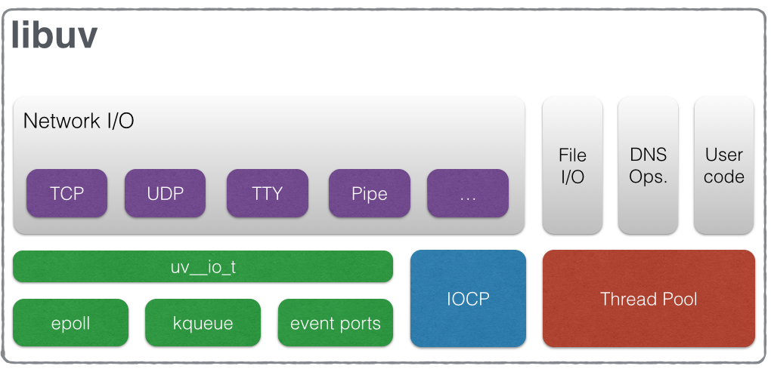
libuv

Slide 26
Integrating
Take V8
Combine it with libuv
Implement some JavaScript API to be consumed by the application
And voila … Node.js

Slide 27
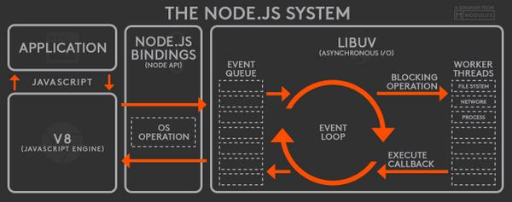
Node.js Architecture

Slide 28
Traditional Web Server
Spawns new thread for each request
May use some kind of thread pool
Each thread consumes memory and increases context switching
Thread blocks when accessing file system/networking
Programmer must synchronize access to shared/static data
Thus increasing even more blocking time

Slide 29
Single Threaded
Only JavaScript code is Single Threaded
NodeJS has multiple worker threads
setTimeout(function() { console.log("timeout"); }, 1000); console.log("Before"); sleep(2000); console.log("After"); function sleep(ms) { const before = new Date(); while(new Date() - before < ms); }
Before
After
timeout

Slide 30
Event Queue
Continuing with our previous sample
What happens after 1000 milliseconds ?
A worker thread handles the timer event by putting an appropriate event inside the queue
Only when our JavaScript code completes it returns to the event loop and fetches the next waiting event

Slide 31
Asynchronous I/O
Node.js uses callbacks to handle async operations
The function returns immediately and the “real work” executes at the background
Once completes, an event is pushed to the event queue waiting to be processed by the main thread
const fs = require("fs"); fs.readFile("main.js", function(err, buffer) { if(err) { return; } console.log(buffer.toString()); });

Slide 32
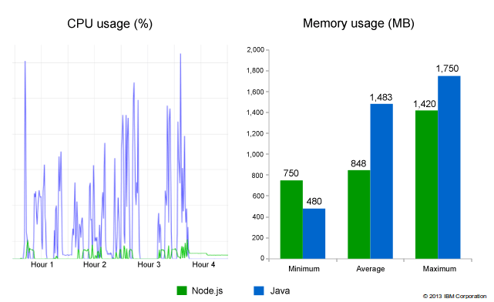
Performance
© 2017 Ori Calvo
4

Slide 33
REPL
Execute “node” and then enter
Interactive mode
Write and evaluate JavaScript code
> node > 8 + 5 13 >

Slide 34
Debugging
node --inspect --inspect-brk main.js
Open Chrome at chrome::/inspect
Wait for remote target list to refresh
Click inspect
Use Console/Sources/Memory tabs

Slide 35
Attach Debugger
Find the PID of the running process
Send SIGUSR1 signal
Windows does not support the SIGUSR1 signal
Can use process._debugProcess(pid) instead
Once the relevant process is signaled can use Chrome as usual
kill -s SIGUSR1 nodejs-pid

Slide 36
modules

Slide 37
Module System
Each file is treated as a separate module
Variables local to the module are private and cannot be accessed by other modules
main.js
const lib = require("./lib"); const log = console.log.bind(console, "main>");
Each module has its own non conflicting log variable
lib.js
const log = console.log.bind(console, “lib>");

Slide 38
Exporting
Exporting a variable/function is done through the exports object
const log = console.log.bind(console, "lib>"); function doSomething() { log("doSomething"); } exports.doSometing = doSomething;
require returns the exports object
const {doSometing} = require("./lib");

Slide 39
Module Wrapper
Each file has its own exports, module and other variables
Node.js achieves that by wrapping your code inside a function
(function(exports, require, module, __filename, __dirname) { // Module code actually lives in here });

Slide 40
Module Scope
__dirname – Full path of the directory containing the current module
__filename – Full path of the current module
exports – We saw that already
module – Reference to the module object
require – We saw that already

Slide 41
module.exports
The exports object is created by the module system
Sometimes you want to control the exports instance
For example, exporting a class
class Logger { constructor(prefix) { this.log = console.log.bind(console, prefix + ">"); this.warn = console.warn.bind(console, prefix + ">"); this.error = console.error.bind(console, prefix + ">"); } } module.exports = Logger;
const {Logger} = require("./logger"); const logger = new Logger("main"); logger.log("In the beginning");

Slide 42
Cyclic Dependencies
In case of cyclic dependency Node.js returns the original module.exports object
Thus, think twice before overwriting it
lib1.js
lib2.js
const lib2 = require("./lib2"); function run() { console.log("lib2", lib2); } module.exports = { run };
const lib1 = require("./lib1"); function run() { console.log("lib1", lib1); } module.exports = { run };
Might be empty object

Slide 43
Resolving require
When using a relative path Node.js follows exactly that path
Same for absolute path
Supported extensions are: .js, .json, .node
require("./lib");
require("/lib");

Slide 44
Resolving require
When specifying non relative/none absolute path Node.js looks for the following locations
Core module: http, fs, path
./node_modules/lib1.js
../node_modules/lib1.js
../../node_modules/lib1.js
Up until the root folder
require("lib1");

Slide 45
Require a folder
It is valid to require a folder. In that case Node.js looks for index.js file
You can change the default name by using a package.json file
{ "main": "main.js" }
Node.js looks for main.js instead of index.js

Slide 46
module.paths
Allows for dynamic modification of the locations Node.js uses when resolving a dependency
module.paths.push("c:\\1"); require("lib");

Slide 47
require.cache
Holds a map of all loaded modules
Can manipulate it and force module reload
const path = require("path"); require("./lib"); delete require.cache[path.resolve(__dirname, "./lib.js")]; require("./lib");
Delete reference to module object from require.cache

Slide 48
Native Modules
When Node.js public API is not enough you may implement native modules which access OS directly
Not straight forward ☹
Need to write cross platform C++ code
May use libuv to achieve that
Must use V8 APIs to interact with JavaScript code
V8 changes a lot over time
Thus, native module tend to break cross Node.js versions

Slide 49
C++ Addon
#include <node.h> namespace demo { using v8::FunctionCallbackInfo; using v8::Isolate; using v8::Local; using v8::Object; using v8::String; using v8::Value; void Method(const FunctionCallbackInfo<Value>& args) { Isolate* isolate = args.GetIsolate(); args.GetReturnValue().Set(String::NewFromUtf8(isolate, "world")); } void init(Local<Object> exports) { NODE_SET_METHOD(exports, "hello", Method); } NODE_MODULE(NODE_GYP_MODULE_NAME, init) } // namespace demo

Slide 50
Compile the Addon
Create binding.gyp file
npm install –g node-gyp
node-gyp configure → Makefile/vcxproj file is created
node-gyp build → addon.node is created
{ "targets": [ { "target_name": "addon", "sources": [ "hello.cc" ] } ] }
const addon = require('./build/Release/addon'); console.log(addon.hello());

Slide 51
Control flow

Slide 52
The Challenge
Node.js asynchronous nature impose non intuitive programming model
function readFileIfExists(filePath, callback) { fs.stat(filePath, function (err, stat) { if (err) { callback(err); return; } if (stat.isFile()) { fs.readFile(filePath, function (err, data) { if (err) { callback(err); return; } callback(null, data.toString()); }); } }); }
Callback hell

Slide 53
async package
Async utilities for node and the browser
npm install async
function readFileIfExists(filePath, cb) { async.seq( fs.stat, (stat, cb) => stat.isFile() ? fs.readFile(filePath, cb) : cb(new Error("Not a file")), )(filePath, cb); }

Slide 54
Promise Flow
Convert each function to promise based
Can wrap that logic inside a promisify helper
function readFile(filePath) { return new Promise((resolve, reject)=> { fs.readFile(filePath, function(err, data) { if(err) { reject(err); return; } resolve(data); }); }); }

Slide 55
promisify
function promisify(func) { return function (...args) { return new Promise((resolve, reject) => { args.push(callback); func.apply(this, args); function callback(err, res) { if(err) { reject(err); return; } resolve(res); } }); } }
es6-promisify package offers an almost identical function

Slide 56
Use the new functions
function readFileIfExists(filePath) { return stat("1.txt").then(stat => { if (stat.isFile()) { return readFile(filePath); } throw new Error("Not a file"); }); }
Return a promise to allow “continuation”
Must throw exception to signal an error

Slide 57
Callback hell ?
The promise flow simplifies code since middle layers does not have to deal with errors
However, the code still suffers from the callback hell
function readFileIfExists(filePath) { return stat("1.txt").then(stat => { if (stat.isFile()) { return readFile(filePath); } throw new Error("Not a file"); }); }

Slide 58
async/await
Code feels almost synchronous
async function readFileIfExists(filePath) { const info = await stat(filePath); if(!info.isFile()) { throw new Error("Not a file"); } return await readFile(filePath); }
async function main() { try { const data = await readFileIfExists("1.txt"); console.log(data.toString()); } catch(err) { console.error(err); } }

Slide 59
Promise Flow
Unfortunately most Node.js APIs are callback based
Need to manually wrap the code
Be careful when wrapping instance methods
Must keep the correct this
const obj = { id: 123, oldStyle: function(callback) { callback(null, this.id); } }; const newStyle = promisify(obj.oldStyle.bind(obj));

Slide 60
Promise Limitation
Promise can be resolved only once
Therefore, it cannot represent a reoccurring event
Stream
Button clicks
Runs immediately

Slide 61
Rxjs
ReactiveX library for JavaScript
A big concept
Some love it, some hate it
Out of scope for us
However, lets take a simple look

Slide 62
Rxjs
Observable generates a stream of values
const filePath = "1.txt"; const source = stat(filePath).switchMap(stat => { if (!stat.isFile()) { throw new Error("Not a file"); } return readFile(filePath); }); source.subscribe(res => { console.log(res.toString()); }, err => { console.error(err); });

Slide 63
General topics

Slide 64
Auto Restart
When developing a web server it is convenient that the server is automatically restarted with each code modification
npm install nodemon
node_modules/.bin/nodemon main.js
Other alternatives
forever
pm2

Slide 65
Yarn
https://yarnpkg.com/en/
Yarn follows the same NPM rules but is considered faster
Has better caching strategic
Automatically creates package.json
Supports workspace

Slide 66
Summary
Node.js is a lean platform
Less Than 20MB of installation
Easily installed and getting started
Lot’s of open source packages
Some time its hard to choose the right one

